Slide 1
AI Driven Smart Appliances Sustainability Analyzer
By: Revathi Dhotre, Srujana , Jyothika

Slide 2
Executive Summary
Initiative Goal: To empower homeowners with tools and insights to evaluate and optimize the energy efficiency of their household appliances, thereby reducing energy consumption and lowering electricity bills.
We recommend implementing an AI-driven application that collects and analyzes data on appliance features and energy consumption, evaluates their sustainability, and provides personalized recommendations to enable users to make informed decisions and implement effective energy-saving measures .
Preliminary analysis indicates that :
Homeowners often lack the necessary tools and insights to optimize energy usage.
Inefficient energy usage leads to higher electricity bills.
Personalized recommendations can significantly improve energy efficiency.
Our approach involved:
Data Collection - Gathering data on user behavior, device efficiency, and preferences.
Model Training - Using machine learning to assess device sustainability.
Personalized Recommendations - Leveraging LangChain and Google PaLM API to provide tailored suggestions for improving energy efficiency.
Streamlit Development - Building and deploying an interactive and user-friendly web application.
We proposes that the steps are:
Deployment and Onboarding: Launch the web application securely, test functionalities, and onboard pilot users with training.
Monitoring and Updates: Track user feedback, refine the model, and update the application.
Rollout and Review: Expand the user base, offer support, and review performance with detailed reports.

Slide 3
Outcome and Methodology
1. Dataset Description and Exploration :
The dataset tracks smart home device usage, capturing metrics like device type, daily usage hours, energy consumption, user preferences, malfunction incidents, and device age, with the target variable indicating device efficiency (0 - Inefficient, 1 - Efficient).
Data Exploration
Examined the first few rows, summary statistics, and data types.
Checked for missing values
Data Pre-Processing
Applied StandardScaler to numerical features and OneHotEncoder to categorical features to standardize and encode the data.
Analyzed distributions of key variables, such as DeviceType and UsageHoursPerDay.
Data Cleaning
Dropped irrelevant columns like user id .
Data Splitting
Divided the dataset into training (67%) and test (33%) sets to train and also evaluate model performance on unseen data.

Slide 4
Outcome and Methodology
2. Developing the ML models :
We evaluate the performance of five machine learning models after training with the given data : Logistic Regression , Random Forest Classifier , Decision Tree, K-nearest neighbour and Support Vector Classifier and below are the outcomes.
Metric | Logistic Regression | Random Forest Classifier | Decision Tree | K-Nearest Neighbour | Support Vector Classifier
Train Accuracy | 87.73% | 100% | 100% | 95% | 92%
Test Accuracy | 86% | 95% | 89% | 93% | 91%
Precision (Average) | 0.87 | 0.95 | 0.89 | 0.90 | 0.91
Recall (Average) | 0.87 | 0.95 | 0.89 | 0.91 | 0.91
F1-Score (Average) | 0.87 | 0.95 | 0.89 | 0.91 | 0.91
Overall Model Performance | Average | Excellent | Average | Good | Good
Random Forest Classifier stands out with excellent performance, achieving perfect training accuracy and the highest test accuracy (95%) among the models.
Logistic Regression, Decision Tree, K-Nearest Neighbors, and Support Vector Classifier have good overall performance, with KNN and SVC showing slightly better precision, recall, and F1-scores compared to Logistic Regression and Decision Tree.

Slide 5
3. METHODOLOGY FOR OPTIMIZED SUGGESTIONS
After training the ML models we create personalized suggestions using the below methodology to improve the sustainability.
Data Loading & Thresholds Definition
Load device statistics from the dataset and define thresholds for features.
User Interface
Interactive interface created with Streamlit for input and results display.
User Input & Data Collection
Users input details for multiple appliances (type, usage hours, etc.).
LangChain Integration
Use LangChain to manage interactions between the application and the Google PaLM API, handling complex queries and responses.
Rule-Based Suggestions
Apply predefined rules to assess efficiency and generate basic suggestions.
Comparative Analysis
Compare all input appliances and provide comparative recommendations.
AI-Based Suggestions
Use Google PaLM to generate additional suggestions for improving sustainability.
Alternative Recommendations
Suggest more sustainable alternatives for inefficient appliances.

Slide 6
4. Model Complexity :
Overfitting vs. Underfitting: Decision Tree tends to overfit with perfect training accuracy but lower test accuracy, while Random Forest mitigates overfitting by averaging multiple trees, achieving better generalization.
Computational Complexity: Logistic Regression is computationally efficient and quick to train, whereas Random Forest and SVC require more time and resources due to their complexity.
Rule-Based System: Static conditions and rules increase complexity with more rules and specific conditions, requiring ongoing updates.
AI Model Integration: Google PaLM handles complex predictions and adaptations, involving data preprocessing and continuous model retraining.
LangChain Layer: Manages natural language queries and optimizes responses, adding complexity in interaction management.
5. Next Steps for Maturing the Model
1. Monitor and Retrain ML model : Continuously monitor the ML model performance with new data and periodically retrain the model to adapt to changes in data patterns, ensuring sustained accuracy and relevance.
2. Enhance Rule-Based Logic: Refine and expand the rule set to improve accuracy and handle more diverse scenarios. Integrate user feedback to continuously update and optimize these rules.

Slide 7
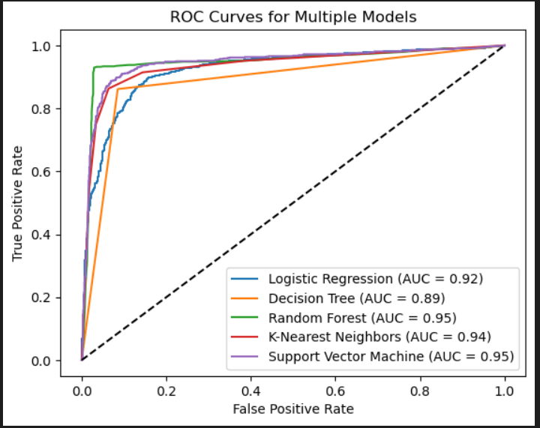
Proving this works using Evaluation metrics
Precision: Measures the proportion of true positives among all positive predictions. Useful for understanding how many of the predicted positive cases are actually positive.
Recall: Measures the proportion of true positives among all actual positives. Indicates how well the model captures all positive cases.
F1 Score: Harmonic mean of precision and recall. Provides a balance between the two metrics, especially useful when dealing with imbalanced classes.
ROC Curve: Plots the true positive rate against the false positive rate at various threshold settings. Helps in visualizing the trade-off between sensitivity and specificity.
AUC (Area Under the Curve): Represents the overall performance of the model across all classification thresholds. A higher AUC indicates a better model performance.

Slide 8
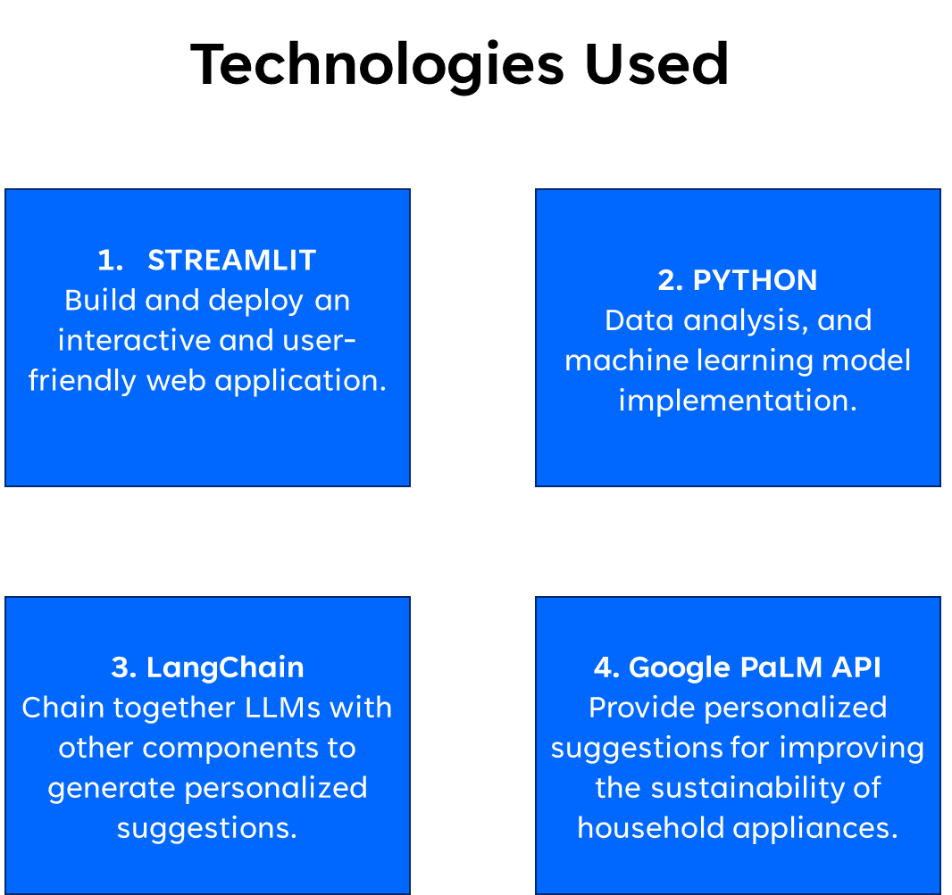

Slide 9
Business Value
Visualization
Bar charts depicting the distribution of devices in the data set
ROC curves of each model to select which one is the best
Enhanced Decision making
Improved accuracy and efficiency
Competitive advantage
Convenience
Values

Slide 10
Deployment Plan and Integration
User centric streamlit design
User friendly interface which allows easy navigation
Accessibility features
Good colour contrast and font size
Clear Visualizations
Presenting data in an understandable manner
Ease of use
Streamlit sharing
Ideal for quick deployment
GitHub
Pushing the app to GitHub and connecting to streamlit
Deployment

Slide 11
Recommendations and Next Steps
Advanced Analytics – To integrate more sophisticated features such as trend analysis to offer deep insights
Multi-platform support- extend support to additional platforms, such as mobile apps or integration with voice assistants.
Market expansion- explore opportunities to enter new markets or industry segments by adapting the solution to meet specific needs and regulations
Innovation and R&D- Invest in research and development to stay ahead of technological advancements and incorporate innovative solutions.

Slide 12
Appendix: Key analyses
Data collection
Data preprocessing
Model evaluation
Model training
Data cleaning
Data Transformation
One Hot encoding
Feature engineering
Splitting data
Increased the model’s accuracy

